Slide 1

Chemistry 2
Lecture 4
Quantitative MO Theory for Beginners:
Cyclic π Systems

Slide 2
Learning outcomes from Lecture 3
Be able to explain why confining a particle on a ring leads to quantization of its energy levels
Be able to explain why the lowest energy of the particle on a ring is zero
Be able to apply the particle on a ring approximation as a model for the electronic structure of a cyclic conjugated molecule (given equation for En).
Assumed knowledge
Be able to predict the number of π electrons and the presence of conjugation in a ring containing carbon and/or heteroatoms such as nitrogen and oxygen. Be able to convert between energy and spectroscopic units (J, eV, Hz and nm)

Slide 3
“The particle on a ring”
j = 3
All singly degenerate
Doubly degenerate
above j=0
n = 4
j = 2
n = 3
n = 2
j = 1
n = 1
j = 0
box
ring

Slide 4
The Coulomb integral, α
α is known as the Coulomb integral and takes account of the self energy of an orbital and the attractive potential of the other nuclei. Since this is attractive, the Coulomb integral is negative. At large interatomic distances, the value of this integral is the atomic orbital energy, which is also negative.
r

Slide 5
The Resonance integral, β
β is a measure the strength of the bonding interaction
as a result of the overlap of orbitals ψ2pA and ψ2pB. It is negative (attractive) where the orbitals constructively overlap, and is zero at large separation.
r

Slide 6
Interacting π orbitals
ε
α−β
π∗
α
2pA
2pB
α+β
π
When two p-orbitals interact, they are split by 2β. The bonding orbital has an energy of α + β, where both integrals are negative.

Slide 7
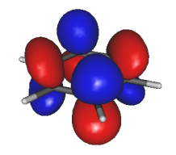
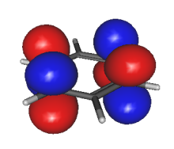
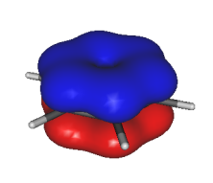
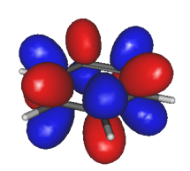
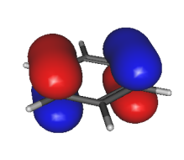
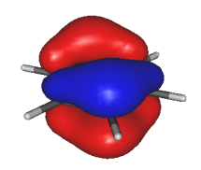
π MOs of Benzene
Maybe we can model the π-electrons as orbitals multiplied by waves?

Slide 8
π MOs of Benzene
cos(3θ)
where is sin(3θ)??
sin(2θ)
cos(2θ)
sin(1θ)
cos(1θ)
cos(0θ)
θ = π/3
θ = 0

Slide 9
MOs on a ring
these are the unhybridized 2p orbitals
φ2
φ1
φ3
this is the
particle-on-a-ring wave
this is here to keep the total “probability” to 1
φ6
φ4
φ5
also
Construct MOs as atomic orbitals multiplied by the particle-on-a-ring wavefunctions.

Slide 10
orbital energies
Coefficients of p orbitals given by
Particle-on-a-ring wavefunction
for benzene, see appendix for derivation

Slide 11
π orbitals of benzene
α−2β
j = 3
α−β
j = 2
The six p orbitals all
have the same energy
… interact and mix
α+β
j = 1
α+2β
j = 0

Slide 12
a geometrical mnemonic
φ3
φ2
φ1
φ6
φ4
φ5
α−2β
j = 3
α−β
j = 2
α
2β
2π/6
α+β
2β
j = 1
α+2β
j = 0

Slide 13
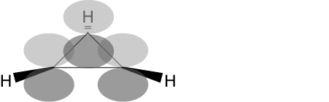
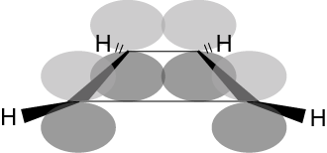
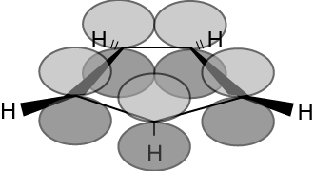
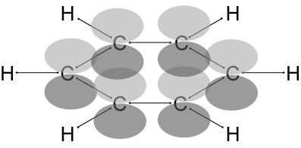
a geometrical mnemonic for N-membered rings
α−2β
α
α+2β
cyclopropenyl
radical
cyclobutadiene
cyclopentadienyl
radical
benzene

Slide 14
a geometrical mnemonic for N-membered rings centred at ε=α, radius=2β
α−2β
α
α+2β
4n+3,
n = 0
4n,
n = 1
4n+1,
n = 1
4n+2,
n = 1
4n+2 membered rings are stable, and are refered to as aromatic.

Slide 15
benzene
Question: what is the energy of the HOMO-LUMO transition, given the formula for the energy levels?
Answer: We find that the transition is from
j = 1 to j = 2. Substituting,
j = 2
?
j = 1
j = 0
The HOMO-LUMO transition is -2β.

Slide 16
benzene
Question: from the calculated expression of the HOMO-LUMO transition, calculate an experimental value for the resonance integral, β, taking
1) the intense transition in the figure for calibration,
2) the lowest energy transition for calibration.
180 nm
260 nm
j = 3
Answer: The calculated energy of the
HOMO-LUMO transition is -2β. This
corresponds to photons of wavelength
around 180 nm, for the intense
transition, or 260nm for the lowest
transition. Thus,
-2β = hc/(180×10⁻⁹)
= 1.10×10⁻¹⁹ J = 6.89 eV
β = -3.44 eV or
β = -2.38 eV
Hiraya and Shobatake, J. Chem. Phys. 94, 7700 (1991)
j = 2
j = 1
j = 0

Slide 17
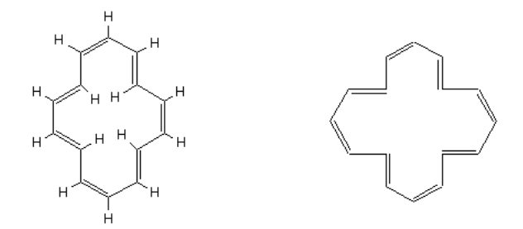
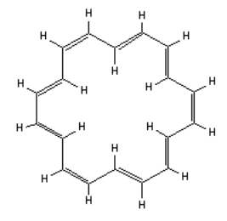
annulenes
Question: [14]-annulene and [16]-annulene are pictured. Which is aromatic?
Answer: The 4n+2 rule applies to [14]-annulene, n=3, but not [16]-annulene, which is antiaromatic.
[14]-annulene
[16]-annulene
Question: How many π-electrons in [18]-annulene? What are the values of j for the HOMO and the LUMO?
Answer: There are 18 π-electrons, so the transition is from j = 4 to j = 5. (draw a picture)
[18]-annulene

Slide 18
annulenes
Question: Predict the lowest energy at which [18]-annulene might absorb strongly, given your smaller calculated value for β from benzene.
Answer:
[18]-annulene
This corresponds to 750 nm, or 13300 cm⁻¹,
which is a value supported by experiment.

Slide 19
Learning outcomes
Recall and apply the 4n+2 rule for aromaticity
Recognize and interpret the polygon mnemonic for the energy levels of a conjugated cyclic compound.
Be able to apply molecular orbital theory as a model for the electronic structure of a conjugated ring molecule (given equation for Ej).

Slide 20
Next lecture
Vibrational spectroscopy: the simple harmonic oscillator
Week 10 tutorials
Schrödinger equation and molecular orbitals for diatomic molecules

Slide 21
Practice Questions
Benzene absorbs at 260 nm, corresponding to the HOMO – LUMO transition.
  What is the spectroscopic value of β in eV and Joules.
  Calculate the total energy of the π electrons in benzene using this value
  An isolated C=C π bond has energy σ + β. What is the total energy of the π electrons in three C=C bonds
  Using your answer to (b) and (c), what is the aromatization energy?
Draw a circle and inscribe an equilateral triangle inside such that one vertex lies at the 6 o’clock position. The points at which the two figures touch are the π energy levels.
Repeat for 4, 5 and 6 membered rings.

Slide 22
Appendix
The following is a derivation of the energy formula for molecular orbitals on a ring.

Slide 23
complex wavefunctions
φ2
φ1
φ3
φ6
φ4
φ5
Since the sin and cos wavefunctions are degenerate, we may make linear combinations of these to make new solutions. It will simplify the mathematics to use these complex forms of the wavefunctions. We can now distinguish between the two degenerate solutions as ±j, which is like going around the ring one way, or the other.

Slide 24
energies
α
ignored
β
The interaction between an orbital and itself is α, the Coulomb integral.
The interaction between an orbital and an adjacent one is the Resonance integral, β.
The interaction between non-adjacent orbitals is ignored.

Slide 25
energies
to the right
neighbours to the left

